Slide 1

Talent Development Program
Module 2 : T-SQL
Session 23 : Fragmentation & Maintenance
Notes:
This template can be used as a starter file for presenting training materials in a group setting.
Sections
Right-click on a slide to add sections. Sections can help to organize your slides or facilitate collaboration between multiple authors.
Notes
Use the Notes section for delivery notes or to provide additional details for the audience. View these notes in Presentation View during your presentation.
Keep in mind the font size (important for accessibility, visibility, videotaping, and online production)
Coordinated colors
Pay particular attention to the graphs, charts, and text boxes.
Consider that attendees will print in black and white or grayscale. Run a test print to make sure your colors work when printed in pure black and white and grayscale.
Graphics, tables, and graphs
Keep it simple: If possible, use consistent, non-distracting styles and colors.
Label all graphs and tables.

Slide 2
Session Overview
1
2
How to Find it
3
Maintenance of Index
Discuss Fragmentation
Notes:
This is another option for an Overview slide.

Slide 3
Learning Objectives
Understand what fragmentation is and how it negatively affects queries
Find fragmentation
Perform maintenance needed for indexes
Notes:
What will the audience be able to do after this training is complete? Briefly describe each objective how the audience will benefit from this presentation.

Slide 4

What is Fragmentation?
Caused by DML actions
Creates empty spaces in the B-Tree known as memory bubbles
Page splitting can also cause fragmentation when data needs more room than allowed in a single leaf node

Slide 5
Types of Fragmentation
Internal Fragmentation
External Fragmentation
Leaf nodes not filled to fullest capacity due to memory bubbles
Focus on Balance Tree and data inside
If there is a NCI on a CI, then the memory bubbles on the CI will cascade up through the NCI
Logical order does not match Physical in HDD
Similar to typical Fragmentation in HDD’s
Causes serious issues due to increase in Fetch operations which must search for data in the HDD

Slide 6
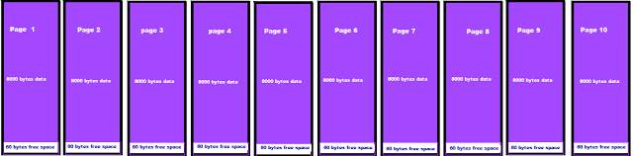
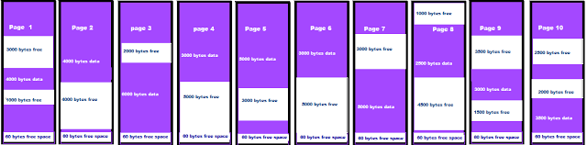
Internal Fragmentation

Slide 7
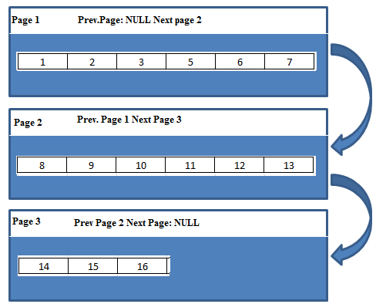
External Fragmentation

Slide 8
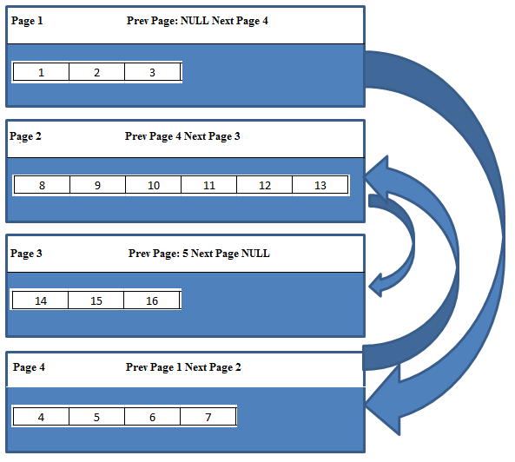
External Fragmentation

Slide 9
Find Fragmentation Levels
GUI
Right click and check the properties of index, on the right column there’ll be Fragmentation
DB Console Command
DBCC showcontig(‘tbl’,Index)
Find info displayed about the indexes on the table
Dynamic Management Views
Using a system view that has dynamic values we search for two columns
sys.dm_db_index_physical_stats (
{ database_id | NULL | 0 | DEFAULT }
, { object_id | NULL | 0 | DEFAULT }
, { index_id | NULL | 0 | -1 | DEFAULT }
, { partition_number | NULL | 0 | DEFAULT }
, { mode | NULL | DEFAULT }
)
Modes : Sample / Detailed

Slide 10
Maintenance on Indexes
Reorganize
Rebuild
Easier and less resource heavy
Fixes the physical ordering of leaf pages and compresses data to fix empty spaces
If canceled mid way, it will stop and end where it’s at. No rollback is taken
Heavier and more resource consuming
Creates an entirely new Balance Tree structure for the index
= Dropping old / + New
If canceled mid way, it will roll back its operations

Slide 11
Maintenance on Indexes
Reorganize
Rebuild
External Guidelines
5% - 30%
Internal Guidelines
95% - 70%
External Guidelines
30% - 100%
Internal Guidelines
70% - 0%

Slide 12
Additional Options for Rebuild
Fillfactor
Give the percentage of space to be allocated for data in the leaf pages for the rebuild
Pad_Index
Apply the percentage for fill factor to all levels of the Balance Tree
Online
Allows for the data in the underlying table to still be queried and updated as the index is created
Statistics_Norecompute
Keep the original stats
Sort_In_TempDB
Create using TempDB

Slide 13
Questions?
Notes:
Is your presentation as crisp as possible? Consider moving extra content to the appendix.
Use appendix slides to store content that you might want to refer to during the Question slide or that may be useful for attendees to investigate deeper in the future.

Slide 14

Summary
Discuss what the cost is for indexes, and how that cost would influence having them
Explain how to find fragmentation and fix it
Explain the two different types of fragmentation
Notes:
Summarize presentation content by restating the important points from the lessons.
What do you want the audience to remember when they leave your presentation?
Save your presentation to a video for easy distribution (To create a video, click the File tab, and then click Share. Under File Types, click Create a Video.)

Slide 15
Thank You
Notes:
Is your presentation as crisp as possible? Consider moving extra content to the appendix.
Use appendix slides to store content that you might want to refer to during the Question slide or that may be useful for attendees to investigate deeper in the future.

